Slide 1
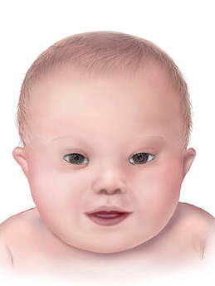
Down Syndrome
By: Teja Mallela

Slide 2
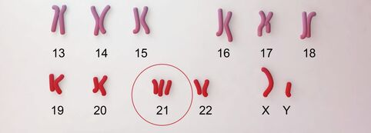
What is Down Syndrome?
Caused by trisomy of chromosome 21
The most common genetic development disorder
Notes:
At an incidence of about 1 case per 800 live births, Down syndrome is the most common genetic development disorder. Down syndrome is caused by a trisomy of chromosome 21 (having three copies instead of two copies). This extra copy of chromosome 21 is a result of abnormal cell division of either the sperm or egg cell during development. Down syndrome can be detected 12 to 13 weeks into pregnancy and will cause several abnormalities in affected individuals throughout their developmental years. Down syndrome cannot be cured and symptoms will stay with individuals for the rest of their lives. However, support and treatment options can help affected individuals manage their condition so that they can live happy and fulfilling lives. [1,2,3]

Slide 3
Symptoms
Distinct physical features
Several behavioral & neurodegenerative symptoms
Notes:
Down syndrome individuals have very distinct physical features that include: a short neck, flattened face and nose, small mouth and ears, upward slanting eyes, and decreased muscle tone. Other symptoms that aren't readily noticeable include cognitive and behavioral problems such as: Slow learning Delayed language and speech development Impulsive behavior Increased risk of other health issues (autism, heart/brain abnormalities, etc.)

Slide 4
Diagnosis and Treatment
​Screening tests
No single, standard treatment available
Notes:
​Screening tests for Down syndrome are a routine part of prenatal care and are usually conducted near the end of the first trimester of pregnancy. A blood test that detects abnormal protein and hormone levels, and a nuchal translucency test that measures the area on the back of the baby's neck are used to estimate the baby's risk of having Down syndrome. Although a single, standard treatment for Down syndrome does not exist, personalized care that focuses on the affected individual's intellectual and physical needs can be implemented. Treatment options could include: speech therapy, physical therapy, and specialized education programs. [1]

Slide 5
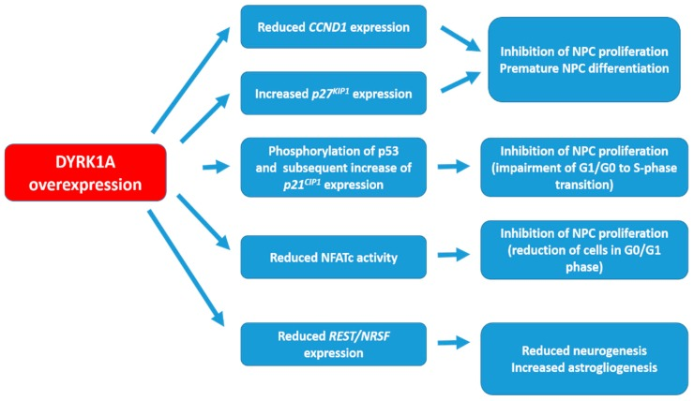
What is the DYRK1A gene’s role in Down Syndrome?
Encodes for a tyrosine-phosphorylating kinase protein
Notes:
Chromosome 21 contains over 200 genes, but there have been several candidate genes identified that play a role in the cognitive impairment that occurs in individuals with Down syndrome. One of these candidate genes is DYRK1A, which encodes for the dual-specificity tyrosine-(Y)-phosphorylation-regulated kinase 1A protein. DYRK1A has received increased attention because it has been associated with cognitive defects in other disorders such as Alzheimer's disease. Because of the extra copy of chromosome 21, DYRK1A is overexpressed in both the fetal and adult periods. DYRK1A plays a role in reduced neurogenesis and premature neuronal differentiation of neuroprogenitor cells, so the overexpression of this gene can lead to several developmental deficits. [1,2,3]

Slide 6
DYRK1A Gene Conservation
P Kinase
Human
Mouse
Zebrafish
Chicken
754aa
754aa
733aa
756aa

Slide 7
DYRK1A Phylogeny

Slide 8
DYRK1A Protein Interactions
Notes:
NFAT is a transcription factor known to upregulate neurogenerative processes
DYRK1A inhibits NFAT nucleic activity by phosphorylating NFAT causing it to leave the nucleus.

Slide 9
Knowledge Gap
DYRK1A protein regulates several neurogenerative processes
Upregulation and downregulation of DYRK1A causes severe phenotypic consequences
How is DYRK1A regulated?
Notes:
Dyrk1a can be a very harmful gene when overexpressed, however, it is also harmful when under-expressed.
In healthy neurons, dyrk1a levels are very steady.
How is dyrk1a regulated? What specific protein structures on dyrk1a and its interaction with other proteins allow for its levels to be tightly regulated in normal neurons?

Slide 10
Model Organism
Notes:
Ts65dn Mouse model
-transgenic mouse with trisomy of several of the orthologs that are overexpressed in humans with trisomy chr 21
-phenotypes and behavior of down syndrome mice are similar to affected humans

Slide 11
Hypothesis
Dyrk1a must be tightly regulated in normal cells.
Overexpression is not corrected in trisomy 21.
Suggests that proteins needed to regulate dyrk1a are not overexpressed and, therefore, not on chr 21.
Notes:
There are other proteins that are required to tightly regulate the dyrk1a levels in cells.
The overexpression of dyrk1a in trisomy is not corrected by these dyrk1a regulatory proteins.
This suggests that the proteins needed to regulate dyrk1a are not also overexpressed and, therefore, not on chr 21.

Slide 12
Aim 1: Identify essential sequences on DYRK1A that are critical for its function
Approach: Use CRISPR to remove highly conserved regions of DYRK1A. Then, observe DYRK1A’s ability to carry out its function.
Hypothesis: Specific regions of DYRK1A are dedicated to its regulation, possibly by other proteins.

Slide 13
Aim 2: Identify proteins that are differently-expressed in the presence and absence of DYRK1A
Approach: RNA-sequencing will be utilized to see which genes are differently-expressed when DYRK1A is present and when absent.
Hypothesis: To upregulate DYRK1A function due to its absence, certain genes will be upregulated. These genes may play a role in regulating DYRK1A.

Slide 14
Aim 3:
Notes:
Still working on Aim 3

Slide 15
Future Directions
These studies could identify new gene targets for Down syndrome gene therapy
Further studies to determine if these new gene could be more useful to target instead of dyrk1a
Notes:
Gene therapy does not specifically have to target the exact gene that is causing the phenotype.
Instead of dyrk1a being a possible candidate for gene therapy, the genes/proteins found in these studies could be targets.
It can be more effective targeting downstream/upstream targets of a particular protein to correct a given phenotype.

Slide 16
References
1. Feki, A., & Hibaoui, Y. (2018). DYRK1A Protein, A Promising Therapeutic Target to Improve Cognitive Deficits in Down Syndrome. Brain sciences, 8(10), 187. Retrieved from: https://www.ncbi.nlm.nih.gov/pmc/articles/PMC6210095/
2. Nguyen, Thu Lan et al. “Correction of cognitive deficits in mouse models of Down syndrome by a pharmacological inhibitor of DYRK1A.” Disease models & mechanisms vol. 11,9 dmm035634. 27 Sep. 2018. Retrieved from: https://www.ncbi.nlm.nih.gov/pmc/articles/PMC5125364/?report=classic
3. Liu, Y., Lin, Z., Liu, M., Wang, H., & Sun, H. (2017). Overexpression of DYRK1A, a Down Syndrome Candidate gene, Impairs Primordial Germ Cells Maintenance and Migration in zebrafish. Scientific reports, 7(1), 15313. Retrieved from: https://www.ncbi.nlm.nih.gov/pmc/articles/PMC5681638/
Notes:
Need to add the rest… my bad.

