Slide 1
Down Syndrome
By: Teja Mallela

Slide 2
Down Syndrome: An extra little chromosome
Teja Mallela

Slide 3
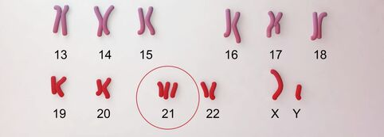
What is Down Syndrome?
Caused by trisomy of chromosome 21
The most common genetic development disorder
Notes:
At an incidence of about 1 case per 800 live births, Down syndrome is the most common genetic development disorder. Down syndrome is caused by a trisomy of chromosome 21 (having three copies instead of two copies). This extra copy of chromosome 21 is a result of abnormal cell division of either the sperm or egg cell during development. Down syndrome can be detected 12 to 13 weeks into pregnancy and will cause several abnormalities in affected individuals throughout their developmental years. Down syndrome cannot be cured and symptoms will stay with individuals for the rest of their lives. However, support and treatment options can help affected individuals manage their condition so that they can live happy and fulfilling lives. [1,2,3]

Slide 4
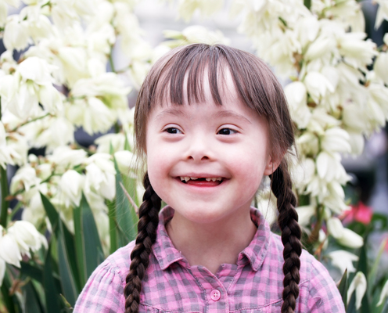
Symptoms
Distinct physical features
Several behavioral & neurodegenerative symptoms
Notes:
Down syndrome individuals have very distinct physical features that include: a short neck, flattened face and nose, small mouth and ears, upward slanting eyes, and decreased muscle tone. Other symptoms that aren't readily noticeable include cognitive and behavioral problems such as: Slow learning Delayed language and speech development Impulsive behavior Increased risk of other health issues (autism, heart/brain abnormalities, etc.)

Slide 5
Symptoms
Distinct physical features
Several behavioral & neurodegenerative symptoms
Notes:
Down syndrome individuals have very distinct physical features that include: a short neck, flattened face and nose, small mouth and ears, upward slanting eyes, and decreased muscle tone. Other symptoms that aren't readily noticeable include cognitive and behavioral problems such as: Slow learning Delayed language and speech development Impulsive behavior Increased risk of other health issues (autism, heart/brain abnormalities, etc.)

Slide 6
Diagnosis and Treatment
​Screening tests
No single, standard treatment available
Notes:
​Screening tests for Down syndrome are a routine part of prenatal care and are usually conducted near the end of the first trimester of pregnancy. A blood test that detects abnormal protein and hormone levels, and a nuchal translucency test that measures the area on the back of the baby's neck are used to estimate the baby's risk of having Down syndrome. Although a single, standard treatment for Down syndrome does not exist, personalized care that focuses on the affected individual's intellectual and physical needs can be implemented. Treatment options could include: speech therapy, physical therapy, and specialized education programs. [1]

Slide 7
DYRK1A Gene
A candidate gene identified to play a role in cognitive impairment
Dual-specificity tyrosine-(Y)-phosphorylation-regulated kinase 1A protein
DYRK1A plays a role in reduced neurogenesis and premature neuronal differentiation of neuro-progenitor cells
Notes:
Chromosome 21 contains over 200 genes, but there have been several candidate genes identified that play a role in the cognitive impairment that occurs in individuals with Down syndrome. One of these candidate genes is DYRK1A, which encodes for the dual-specificity tyrosine-(Y)-phosphorylation-regulated kinase 1A protein. DYRK1A has received increased attention because it has been associated with cognitive defects in other disorders such as Alzheimer's disease. Because of the extra copy of chromosome 21, DYRK1A is overexpressed in both the fetal and adult periods. DYRK1A plays a role in reduced neurogenesis and premature neuronal differentiation of neuroprogenitor cells, so the overexpression of this gene can lead to several developmental deficits.

Slide 8
DYRK1A Gene Ontology
Cellular Component
Molecular Function
Biological Process
Notes:
Cellular Component
DYRK1A is located primarily in the cytosol and can also localize in the nucleolus fibrillar center. The nucleolus fibrillar center is where ribosomes are manufactured by the cell [2].
Molecular Function
DYRK1A is a dual-specificity kinase so it is capable of serine/threonine and tyrosine kinase activity [2].
Biological Process
DYRK1A is known to play a role in cell proliferation signaling pathways by regulating nuclear functions. DYRK1A is also associated with pro-survival functions by negatively regulating apoptotic processes. DYRK1A can promote cell survival by phosphorylating SIRT1 which then inhibits TP53 activity and stops apoptosis [2].

Slide 9
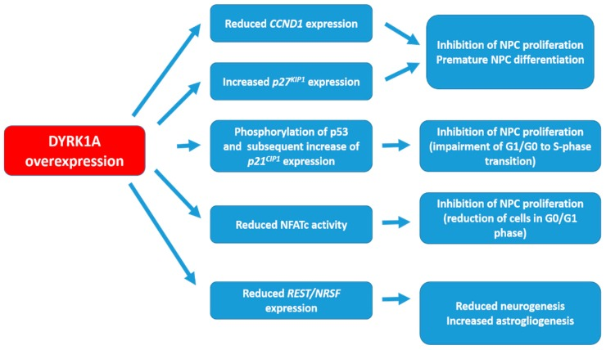
What is the DYRK1A gene’s role in Down Syndrome?
Encodes for a tyrosine-phosphorylating kinase protein
Notes:
Chromosome 21 contains over 200 genes, but there have been several candidate genes identified that play a role in the cognitive impairment that occurs in individuals with Down syndrome. One of these candidate genes is DYRK1A, which encodes for the dual-specificity tyrosine-(Y)-phosphorylation-regulated kinase 1A protein. DYRK1A has received increased attention because it has been associated with cognitive defects in other disorders such as Alzheimer's disease. Because of the extra copy of chromosome 21, DYRK1A is overexpressed in both the fetal and adult periods. DYRK1A plays a role in reduced neurogenesis and premature neuronal differentiation of neuroprogenitor cells, so the overexpression of this gene can lead to several developmental deficits. [1,2,3]

Slide 10
DYRK1A inhibits neuronal differentiation
Encodes for a tyrosine-phosphorylating kinase protein
Notes:
Chromosome 21 contains over 200 genes, but there have been several candidate genes identified that play a role in the cognitive impairment that occurs in individuals with Down syndrome. One of these candidate genes is DYRK1A, which encodes for the dual-specificity tyrosine-(Y)-phosphorylation-regulated kinase 1A protein. DYRK1A has received increased attention because it has been associated with cognitive defects in other disorders such as Alzheimer's disease. Because of the extra copy of chromosome 21, DYRK1A is overexpressed in both the fetal and adult periods. DYRK1A plays a role in reduced neurogenesis and premature neuronal differentiation of neuroprogenitor cells, so the overexpression of this gene can lead to several developmental deficits. [1,2,3]

Slide 11
DYRK1A Gene Conservation
P Kinase
Human
Mouse
Zebrafish
Chicken
754aa
754aa
733aa
756aa

Slide 12
DYRK1A Phylogeny

Slide 13
DYRK1A Protein Interactions
Notes:
NFAT is a transcription factor known to upregulate neurogenerative processes
DYRK1A inhibits NFAT nucleic activity by phosphorylating NFAT causing it to leave the nucleus.

Slide 14
DYRK1A Protein Interactions
Neuro-generative Processes
Notes:
NFAT is a transcription factor known to upregulate neurogenerative processes
DYRK1A inhibits NFAT nucleic activity by phosphorylating NFAT causing it to leave the nucleus.

Slide 15
Knowledge Gap
DYRK1A protein regulates several neurogenerative processes
How exactly does upregulation of DYRK1A cause premature neuronal differentiation?
The mechanism is not fully understood.

Slide 16
Model Organism
Notes:
Ts65dn Mouse model
-transgenic mouse with trisomy of several of the orthologs that are overexpressed in humans with trisomy chr 21
-phenotypes and behavior of down syndrome mice are similar to affected humans
Other options: Rat models, Xenopus

Slide 17
Hypothesis
Overexpression is not corrected in trisomy 21.
DYRK1A’s upregulated kinase activity accelerates cell division in NPCs, causing neurons to divide prematurely.

Slide 18
Aim 1: Identify sequences on DYRK1A that are critical for its role in neuronal differentiation
Approach: Conduct a protein BLAST to determine homologs of DYRK1A. Align the homologs using ClustalOMEGA. Use CRISPR/Cas9 to remove highly conserved regions of DYRK1A. Then, observe the amount of premature NPCs in mice models with and without these conserved regions.
Hypothesis: Specific regions of DYRK1A are linked to cell cycle regulation, the upregulation of these regions cause premature cell division.

Slide 19
Aim 2: Identify proteins that are differently-expressed in the presence and absence of DYRK1A
Approach: RNA-sequencing will be utilized to see which genes are differently-expressed when DYRK1A is present and when absent.
Hypothesis: Upregulated DYRK1A may cause upregulated function of certain genes. These genes may play a role in cell division or proliferation.

Slide 20
Aim 3:
Notes:
Still working on Aim 3

Slide 21
Future Directions
These studies could identify new gene targets for Down syndrome gene therapy
Further studies to determine if these new gene could be more useful to target instead of dyrk1a
Notes:
Gene therapy does not specifically have to target the exact gene that is causing the phenotype.
Instead of dyrk1a being a possible candidate for gene therapy, the genes/proteins found in these studies could be targets.
It can be more effective targeting downstream/upstream targets of a particular protein to correct a given phenotype.

Slide 22
References
1. Feki, A., & Hibaoui, Y. (2018). DYRK1A Protein, A Promising Therapeutic Target to Improve Cognitive Deficits in Down Syndrome. Brain sciences, 8(10), 187. Retrieved from: https://www.ncbi.nlm.nih.gov/pmc/articles/PMC6210095/
2. Nguyen, Thu Lan et al. “Correction of cognitive deficits in mouse models of Down syndrome by a pharmacological inhibitor of DYRK1A.” Disease models & mechanisms vol. 11,9 dmm035634. 27 Sep. 2018. Retrieved from: https://www.ncbi.nlm.nih.gov/pmc/articles/PMC5125364/?report=classic
3. Liu, Y., Lin, Z., Liu, M., Wang, H., & Sun, H. (2017). Overexpression of DYRK1A, a Down Syndrome Candidate gene, Impairs Primordial Germ Cells Maintenance and Migration in zebrafish. Scientific reports, 7(1), 15313. Retrieved from: https://www.ncbi.nlm.nih.gov/pmc/articles/PMC5681638/
Notes:
Need to add the rest… my bad.

